Slide 1
Neural Style Transfer
AI ToolKit
Fall Semester, 2023
Notes:
How can summarize matrices, how matrices can be decomposed.

Slide 2
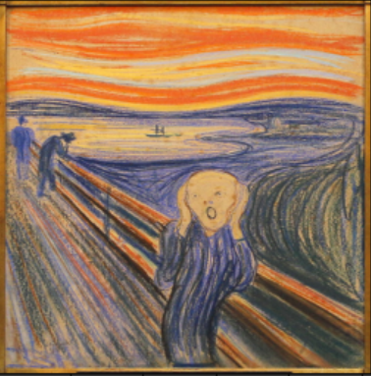


Neural Style Transfer
Style Image
Content Image
Style-transferred Image

Slide 3
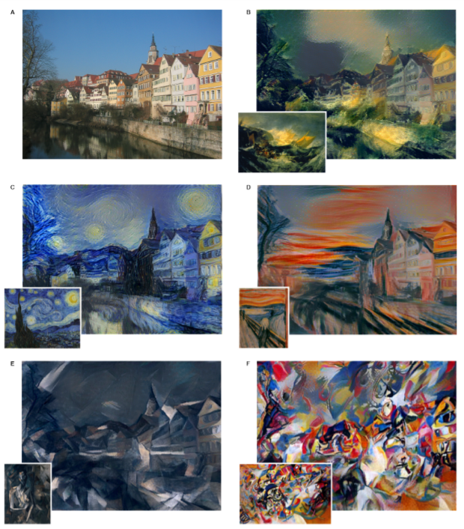
Neural Style Transfer
Given
“CONTENT” and “STYLE” images
To Do
Make “content” image looks like “style” image.
Question
How can we define “content” and “style”?
Style-transferred Image
Image Source : Gatys, L. A., Ecker, A. S., & Bethge, M. (2015). A neural algorithm of artistic style. arXiv preprint arXiv:1508.06576.

Slide 4
Neural Style Transfer
Question
How can we define “content” and “style”?
Can we get this information from trained CNN-based models (i.e., VGG19)
Spatial Feature
Classification
Result
With trained VGG19,
this would be representation of image

Slide 5
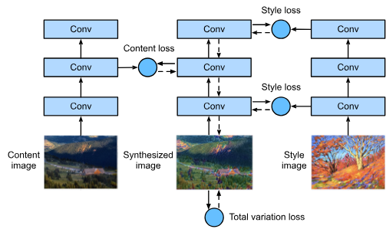
Neural Style Transfer

Slide 6
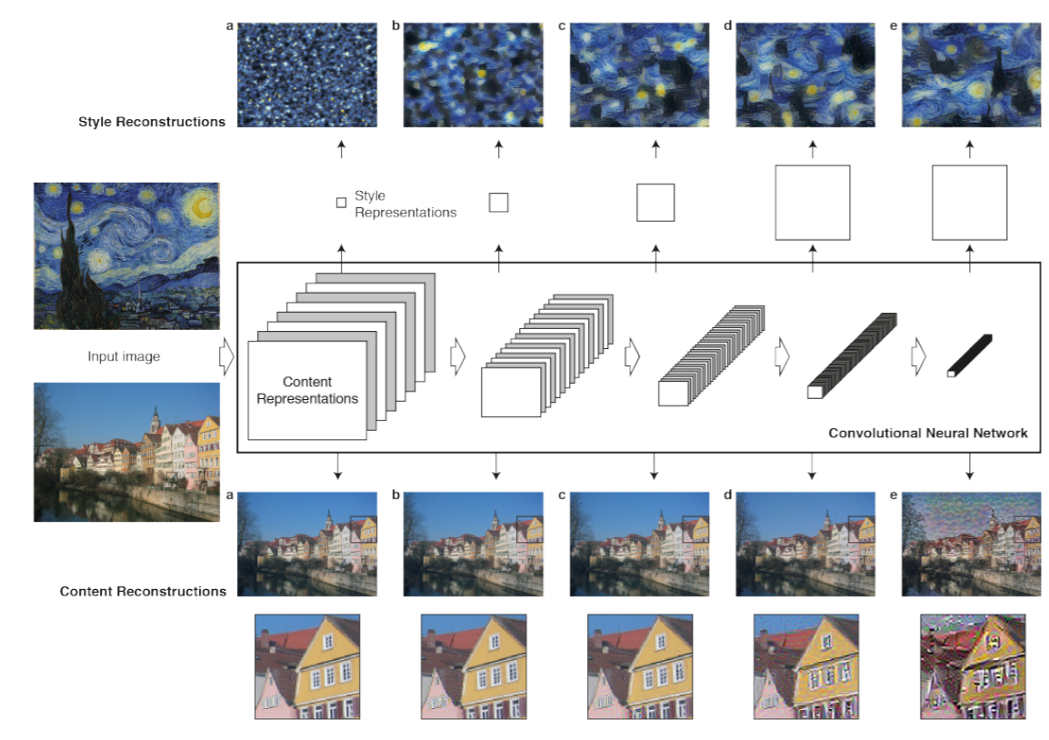
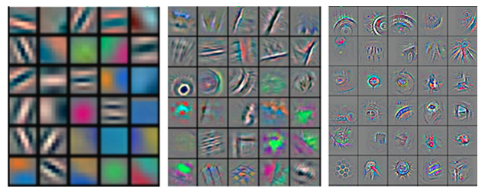
Content Loss
Spatial feature from deeper layer capture high-level “content” of images.
“...We therefore refer to the feature responses in higher layers of the network as the content representation…” (Gatys et. al., 2015)

Slide 7
Content Loss
Content Image
Content Loss
The Only Trainable Parameter
Initialize
Target Image
But..what about style loss?
Style Image

Slide 8
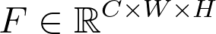
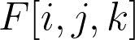
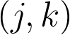
Style Loss
Content Image
Let denote spatial feature.
What does means?
The filter response at position of the th filter.
How the “style” can be defined based on this?
“....Correlations between the different filter responses, where the expectation is taken over the spatial extend of the input image….”
More intuitive way?

Slide 9
Neural Style Transfer
Content Image
Content Loss
The Only Trainable Parameter
Initialize
Generated Image
Style Loss
Style Image

Slide 10
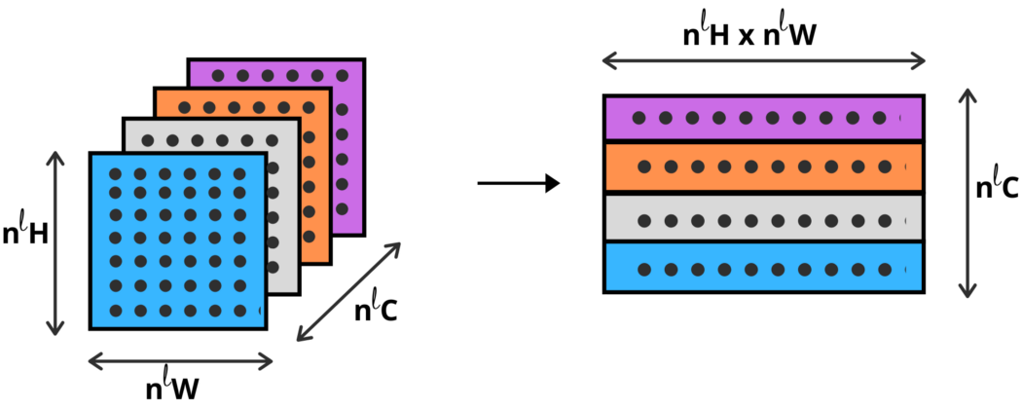
Style Loss
Image Credit : https://towardsdatascience.com/implementing-neural-style-transfer-using-pytorch-fd8d43fb7bfa

Slide 11
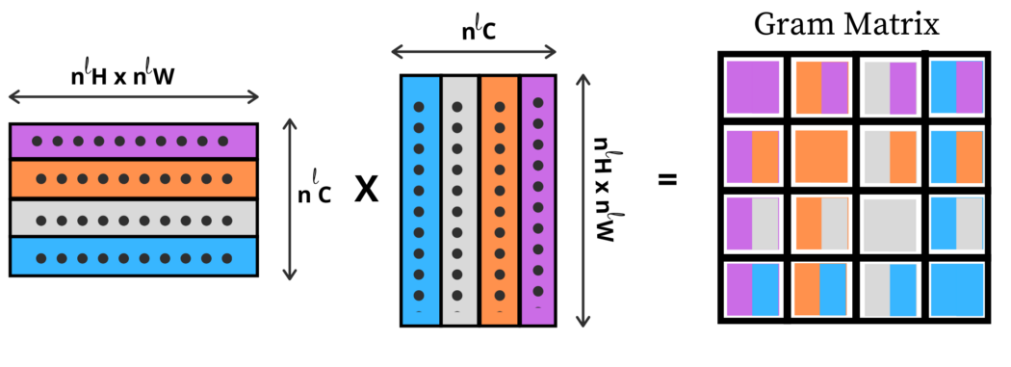
Style Loss
Image Credit : https://towardsdatascience.com/implementing-neural-style-transfer-using-pytorch-fd8d43fb7bfa

Slide 12
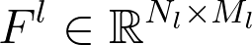

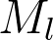
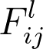
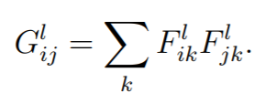
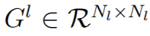
Style Loss
With Gram Matrix, we will calculate how filter responses are correlated to each other.
Let denote the filter response from layer .
: number of filters
: (height * width)
: activation of i-th filter at position j in layer l
Image Credit : https://towardsdatascience.com/implementing-neural-style-transfer-using-pytorch-fd8d43fb7bfa

Slide 13
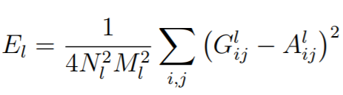
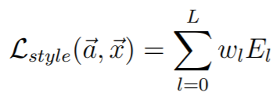
Style Loss
With Gram Matrix, we will calculate how filter responses are correlated to each other.
Let denote the filter response from layer .
: number of filters
: (height * width)
: activation of i-th filter at position j in layer l
a, A : style image and its gram matrix
x, G : generated image and its gram matrix
Image Credit : https://towardsdatascience.com/implementing-neural-style-transfer-using-pytorch-fd8d43fb7bfa

Slide 14
Style Loss
Gram
Matrix?
Filter 1
Filter 2
Image

Slide 15
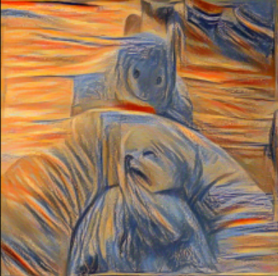
Neural Style Transfer
Style Image
Content Image
Style-transferred Image

Slide 16
Any Questions?

